Slide 1
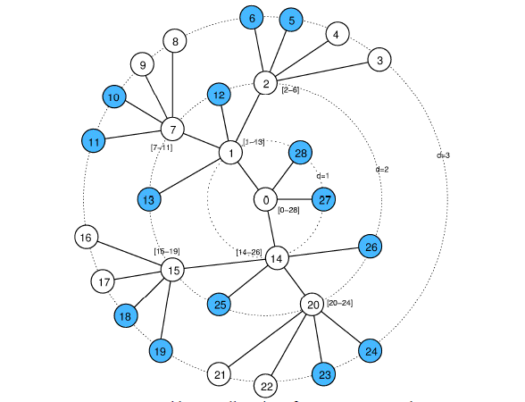
A Technique for Impedance matching in Design of Low Noise Amplifier for ZigBee Receiver frontend
NILAKANTHA SINGH DEO
KIIT University
Srinibasa Padhy
KIIT University

Slide 2
contents
ZigBee
ZigBee standards
ZigBee vs. Wi-Fi vs. Bluetooth
Need for ZigBee
Receiver design and front end
receiver architecture
Need for LNA(low noise amplifier)
Common LNA architecture
Desirable characteristic
LNA design consideration
The small signal analysis
Analysis of impedance
The challenges in LNA design
Matching
Gain
Noise figure
Result
Conclusion
References

Slide 3
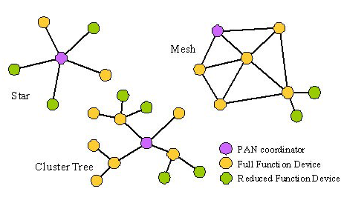
ZigBee standard^{[1]}
IEEE 802.15.4 standard wireless medium access control(Mac) and physical layer (phy)
specifications for low-rate wireless personal area networks (WPANS)
topology mesh, cluster tree and star

Slide 4
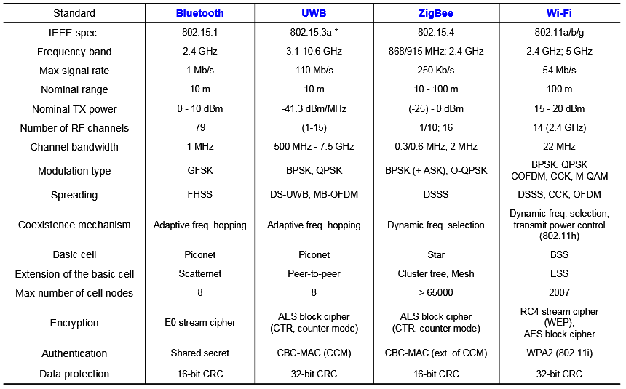
ZigBee vs. Wifi vs. Bluetooth

Slide 5
Need of ZigBee
ZigBee is used in applications that require a low data rate, long battery life, and secure networking. ZigBee has a defined rate of 250 Kbit/s, best suited for periodic or intermittent data or a single signal transmission from a sensor or input device. The technology defined by the ZigBee specification is intended to be simpler and less expensive than other WPANs, such as Bluetooth or Wi-Fi
Decentralization

Slide 6
Receiver architecture
The conventional architecture comprises of a low noise amplifier ,mixer ,Voltage controlled oscillator coupled together with inter staged matching network, balun and filters.
Due to continuous downscaling of channel length in deep submicron CMOS technology in proportion to voltage headroom limitation up to 1.2V and below ,outlays design challenges in the RF front end block.

Slide 7
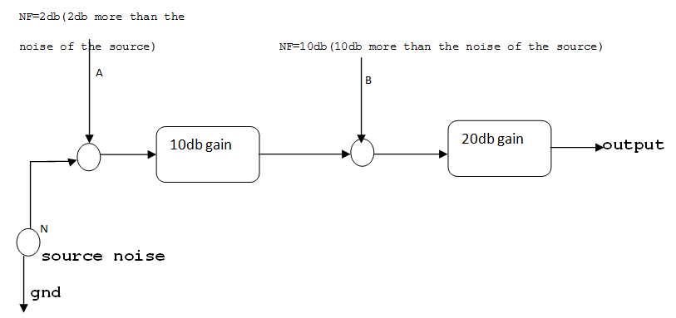
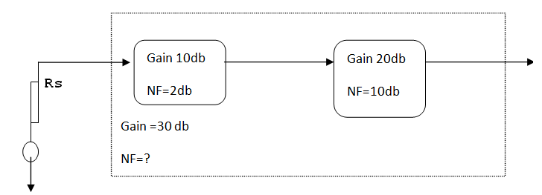
The need for Low Noise Amplifiers motivation
((N+0.5)x10+9N)x100=2400N

Slide 8
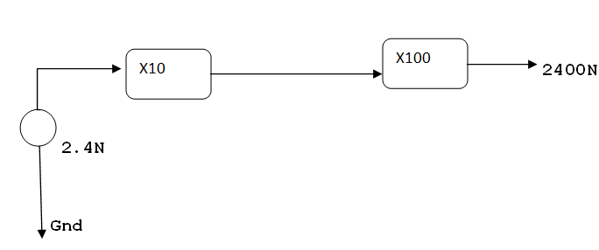
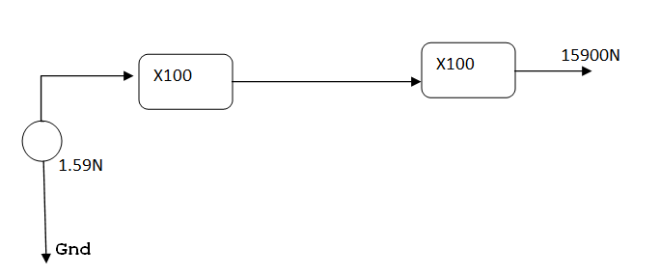
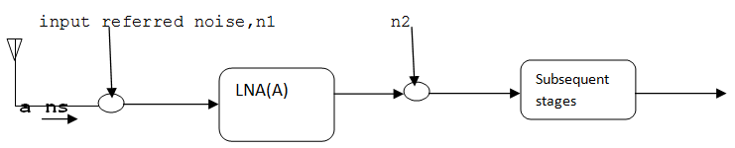

Motivation Cont…
((N+0.5N)x100+9N)x100=15900N
a=signal before LNA
ns=source noise
n1=noise of LNA
n2=noise of subsequent block

Slide 9
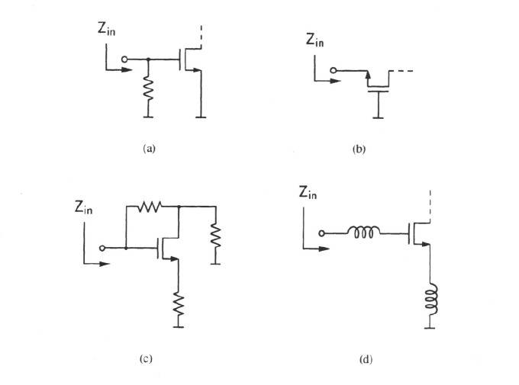
Common LNA architectures^{[9]}
Resistive termination
1/gm termination
Shunt series feedback
Inductive degeneration

Slide 10
Desirable characteristic of LNA
a)large gain
b)low input referred noise (low noise figure)
c)linearity
d)large bandwidth not an issue
e)matching(Zin must be matched with the resistance of the antenna)
because (i)we need to preserve the shape of the signal and (ii)need to have maximum power transfer.

Slide 11
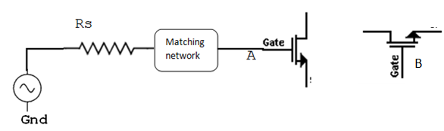
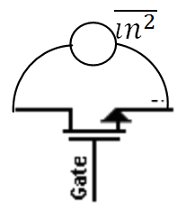

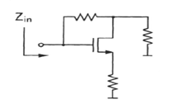
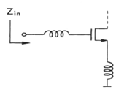
LNA design consideration
=
Figure A
Figure B
Figure C
Figure D

Slide 12
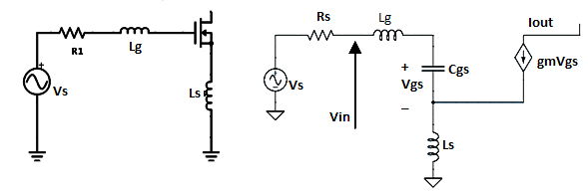
The small signal analysis

Slide 13
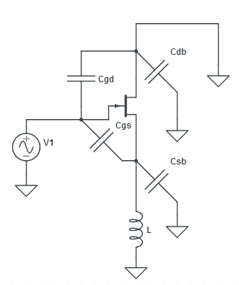
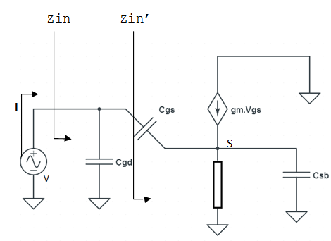
The small signal analysis^{[7]}
Figures are drawn with circuitlab.com

Slide 14

Analysis of impendence
Z resistive
Z capacitive(–gm/w²C)
Z inductive
Final Zin’
Zin’=jwL+(gmL/Cgs)+(1/jwCgs)

Slide 15
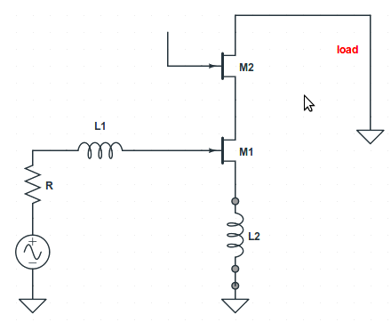
Analysis of impedance
A: The Cgd capacitance
can be dominated by
adding an inductor L1
B: The problem with source degeneration,rg
and gain of the device.
C: Solution the load transfer and matching

Slide 16
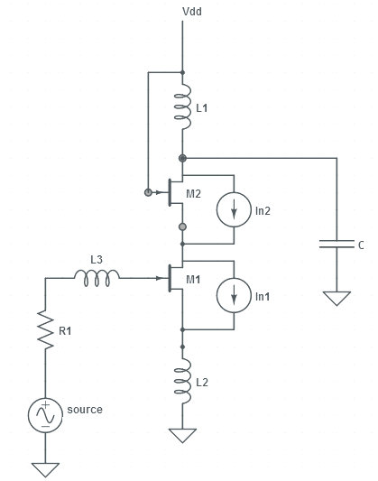
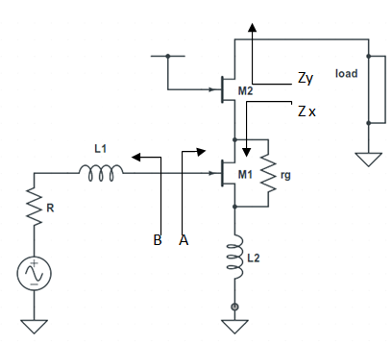
Matching for gain
Circuits are drawn with schemit.com

Slide 17
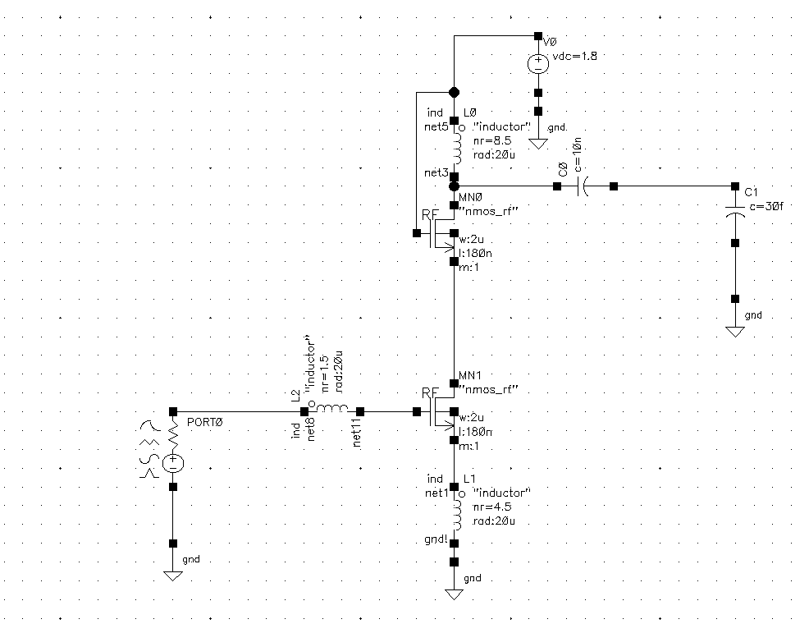
Final circuit
Designed using cadence virtuoso ADEGXL and gpdk180 lib.

Slide 18
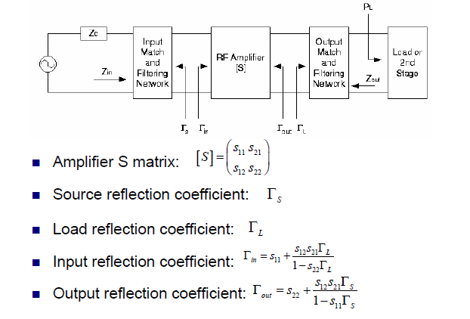
The impendence matching

Slide 19

Impendence matching
b_{S} and b_{L} are the reflected wave from the input and output of the LNA
a_{S} and a_{L} are the incident wave to the input and output of the LNA

Slide 20
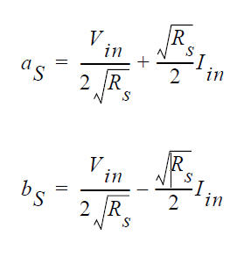
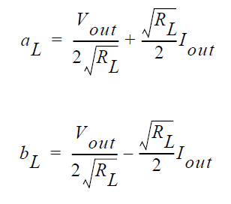
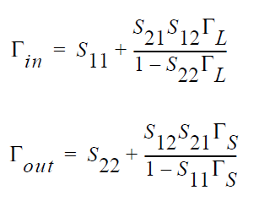

Slide 21
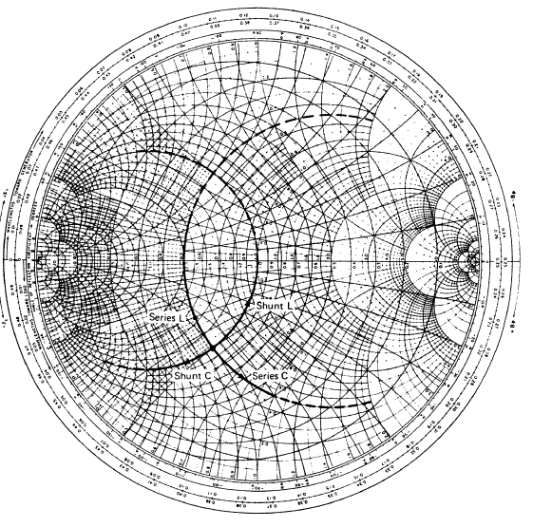
ZY smith (effect of adding series and shunt elements) ^{[14]}
Series L
Shunt L
Shunt C
Series C
Source : Microwave Transistor Amplifiers Analysis and Design^{[14]}

Slide 22
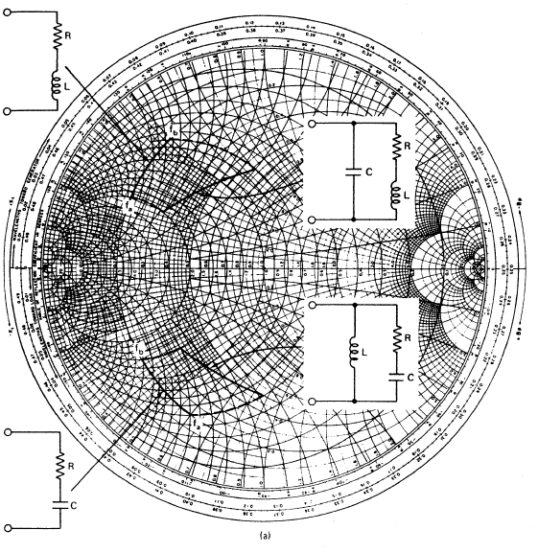
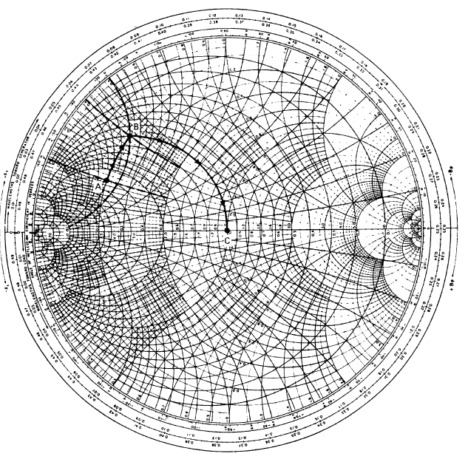
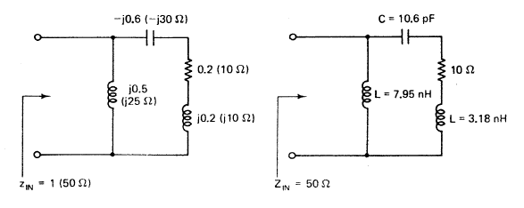
ZY smith

Slide 23
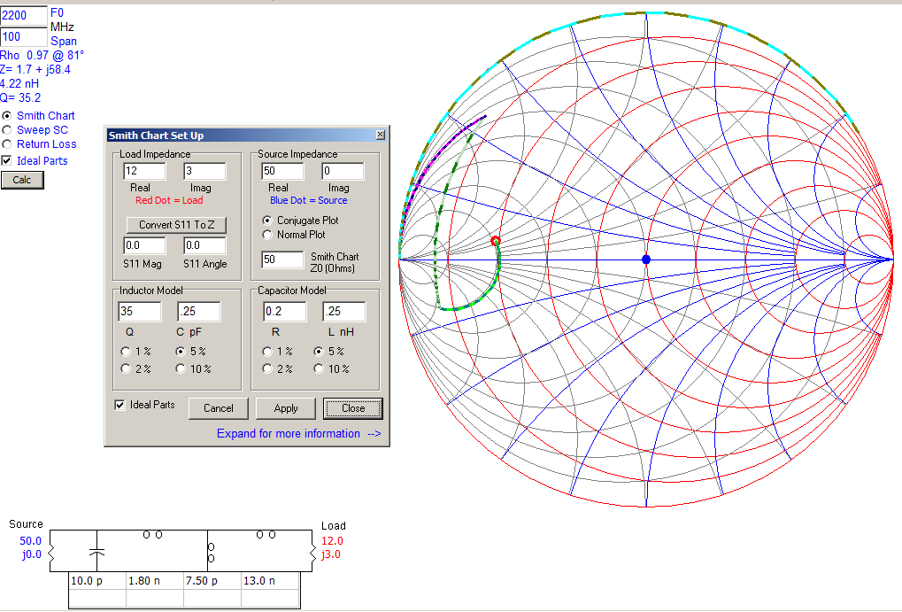
Matching with IOWA
Iowa Hills version 1.3 open source software

Slide 24
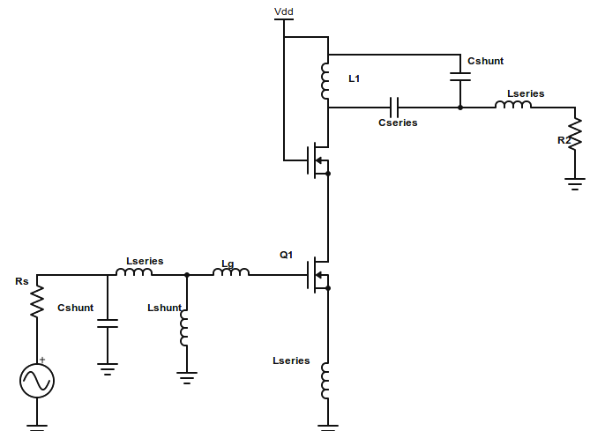
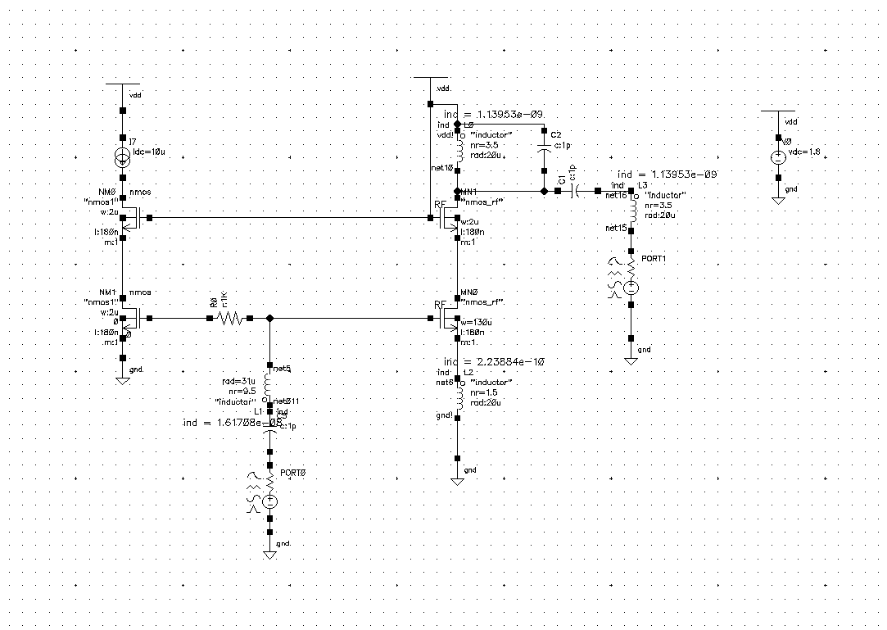
The proposed circuit
The proposed circuit
The simulated circuit

Slide 25
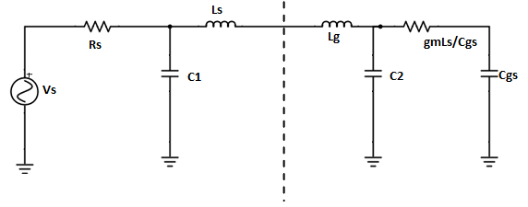
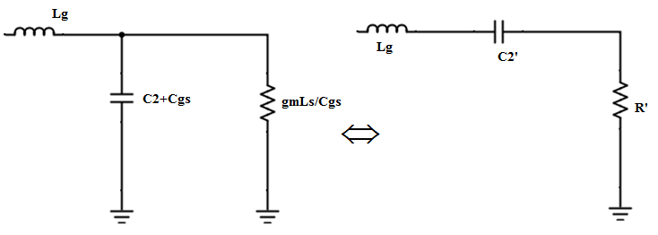
Matching circuit modification
parallel RC to series RC conversion.

Slide 26
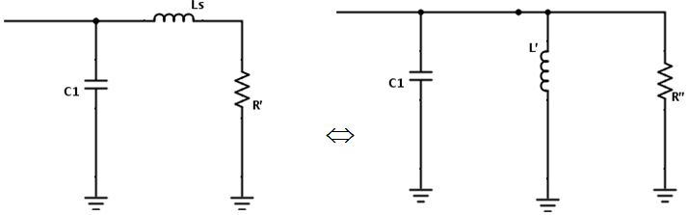
Cont…
series RL to parallel RL conversion

Slide 27
Noise figure calculation

Slide 28
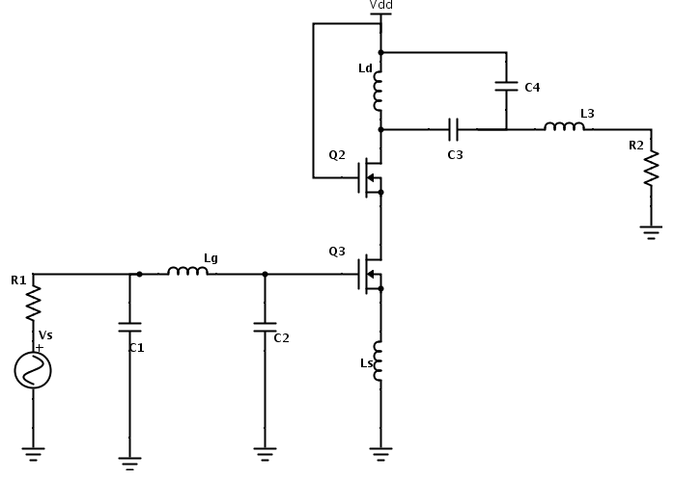
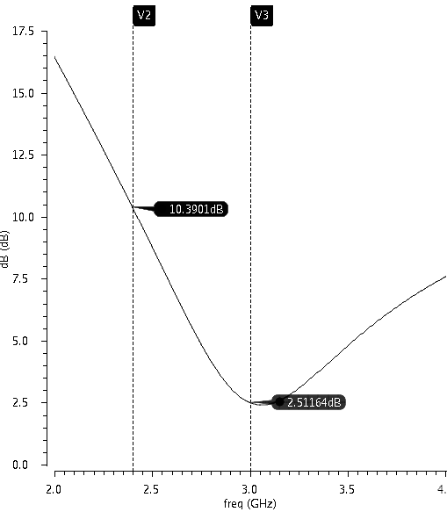
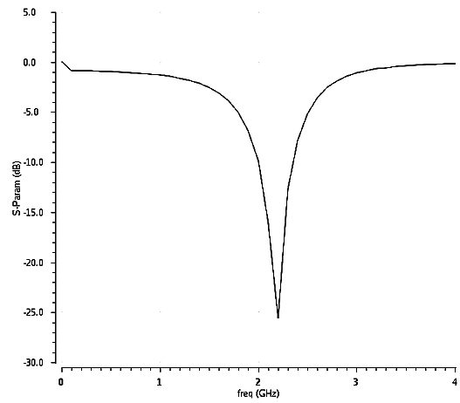
The final circuit and responses
Synthesized circuit
NF (min noise figure 2.5 db at 3GHz)
s11 (-25 dB at 2.4 GHz)
before matching

Slide 29
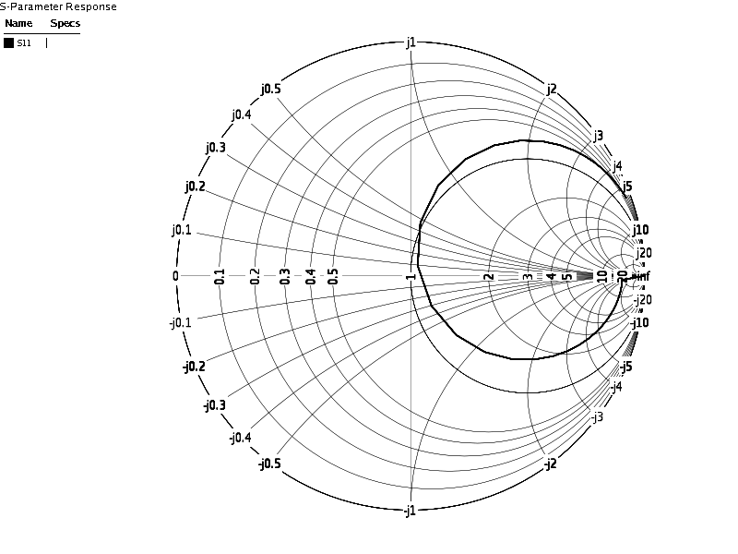
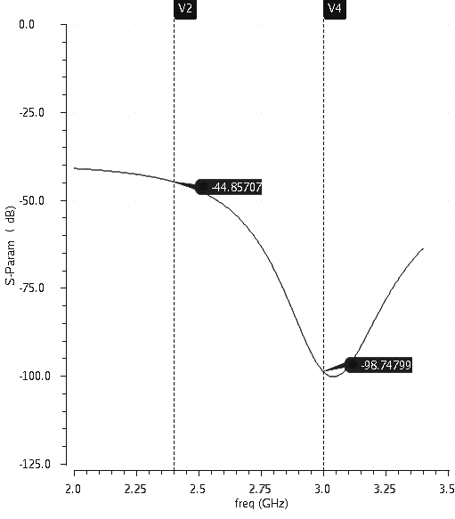
S parameter and smith
s11-parameter responses on Zsmith
s11 (-44dB at 2.4GHz after proper biasing)

Slide 30
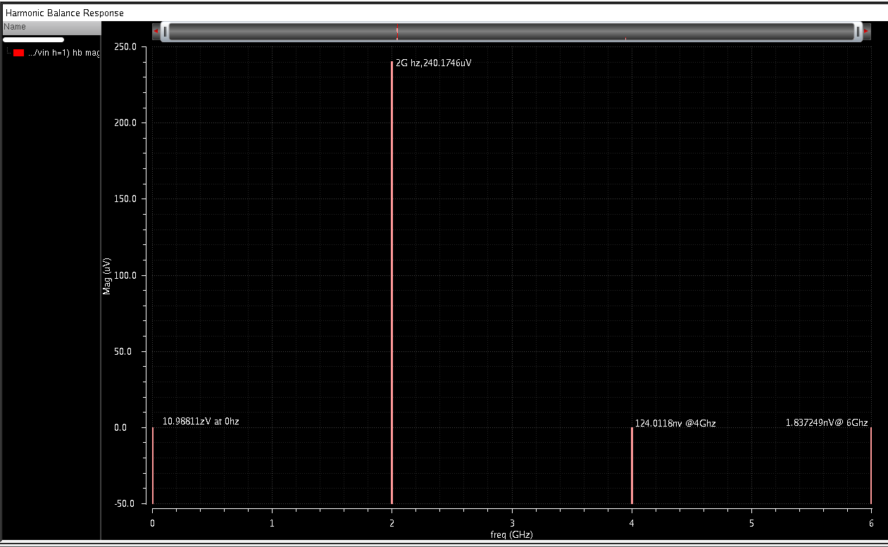
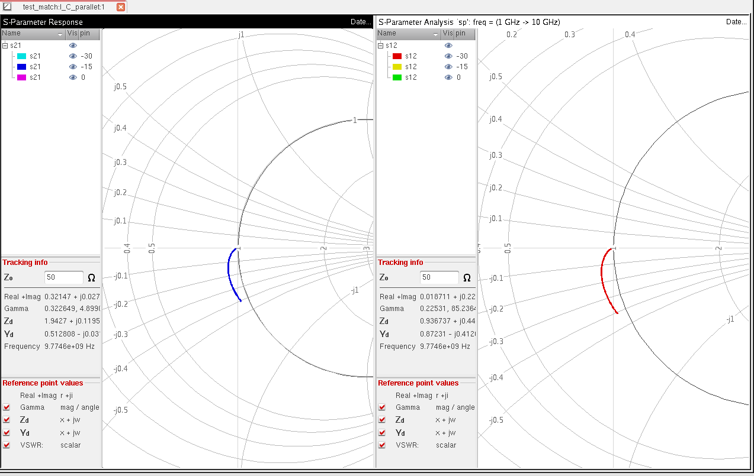
Results :responses after matching^{[10]}
hb analysis
Maximum voltage (240uV) at 2GHz.
Sp analysis:s21 and s12 are matching at
Source 50ohm

Slide 31
Comparison with previous work
specification | NF(dB) | S11(in dB) | frequency(in GHz) | Gain(in dB) | supply voltage(in volt)
This design | 2.5 | -25 | 3 | 15 | 1.8
This design | 10 | -98 | 2.4 | 7 | 1.8
[7] | 7.2 | -37.1 | 2.4 | 22.3 | 0.5
[1] | 7.5 | * | 2.445 | * | 1.8
[2] | 4.6 | * | 2.4 | * | 0.6
[9] | 3.5 | * | 1.46 | 22 | 1.5

Slide 32
References
[1] “2.4-ghz single-ended input low-power low-voltage active front-end for ZigBee applications in 90 nm cmos”,p829,European conference on circuit theory and design,IEEE2011
[2] “A 60uW LNA for 2.4GHz wireless sensor network application”,T.Taris,JB begueret,Y .Deval,IEEE journal on solid state devices 2011
[3] “A gm/Id based methodology for the design of cmos analog circuits and its application to the synthesis of a silicon on insulator micro power OTA” ,, F. Silveira, D. Flandre, and P. G. A. Jespers,ieee journal of solid-state circuits, vol. 31, no. 9, september 1996
[4] “A low power CMOS RF transmitter front end for 2.4 GHz. ZigBee application”,Trung –Kien Nguyen,Nam-jin Oh,Seok-kyun Han,IEEE transaction on solid state devices2006
[5] “Wideband and multi band CMOS LNAs: state of the art and future prospects”, S.Arshad,F.Zafar,R.Ramzan,Q.Wahab, Microelectronics Journal, science direct, Elsevier 2013
[6] “CMOS RFIC architectures for IEEE 802.15.4 networks", John Notor,Anthony Caviglia,Gary Levy(cadence design systems),IEEE Network Magazine 2003.
[7] “Design of ultra-low voltage integrated CMOS based LNA and mixer forZigBee application”, Wei-Keat Chonga et al, International Journal of Electronics and Communications (AEÜ) ,Elsevier July 2013.
[8] “An Area-Efficient Timing Closure Technique for FPGAs using Shannon’s Expansion” ,Deshanand P. Singh and Stephen D. Brown: ICCAD 2002
[9]“The design and implementation of low power CMOS radio receivers”, Derek K Shaeffer,Thomas H.LEE,Kluwer Academic Publishers2002.
[10] “LNA design using SpectreRF application note”, Cadence design systems, product version5,December 2003
[11] “Virtuoso Spectre Circuit Simulator RF Analysis User Guide", cadence design systems ,product version 6.2
[13] “The synthesis of two terminal switching circuits”, Bell Labs journal (Alcatel Lucent) 1949
[14] “Microwave Transistor Amplifiers Analysis and Design", Guillermo Gonjalez,Miamiuniversity,prentice hall 1984

Slide 33
Contribution
“A Technique for Impedance Matching in Design of Low Noise Amplifier for ZigBee Receiver Frontend”, Nilakantha Singh Deo, Srinibasa Padhy, CCSN micro 2014,IEEE GOLD conference July 2014 KOLKATA

Slide 34
Thank you
Presented by: Nilakantha Singh Deo
Roll no:1259023
MT.ech: VLSI Design and embedded systems
Guided by: Asst.Prof. Srinibas Padhy
Thank you
Presented by: Nilakantha Singh Deo
Roll no:1259023
MT.ech: VLSI Design and embedded systems
Guided by: Asst.Prof. Srinibas Padhy

